Slide 1
Pride and Prejudice Peter Grimes
Appreciation of English and American literature Week 6

Slide 2
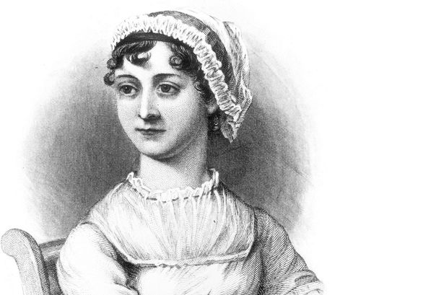
Jane Austen (1775 -1817)
Her novels’ themes are:
marriage, class, and wealth – high society romance (often told with some irony).
She became increasingly well-known in the twentieth century and academics cited her importance to English literature.
Her writing has been credited with developing the novel toward ‘Realism’.

Slide 3
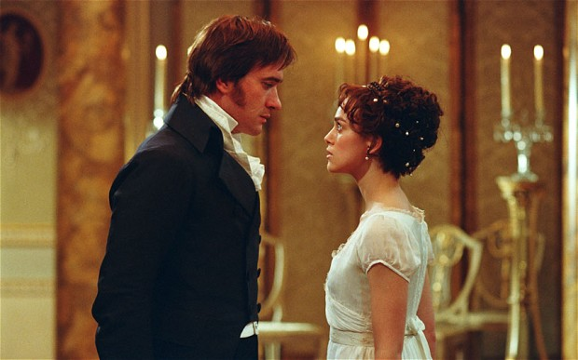
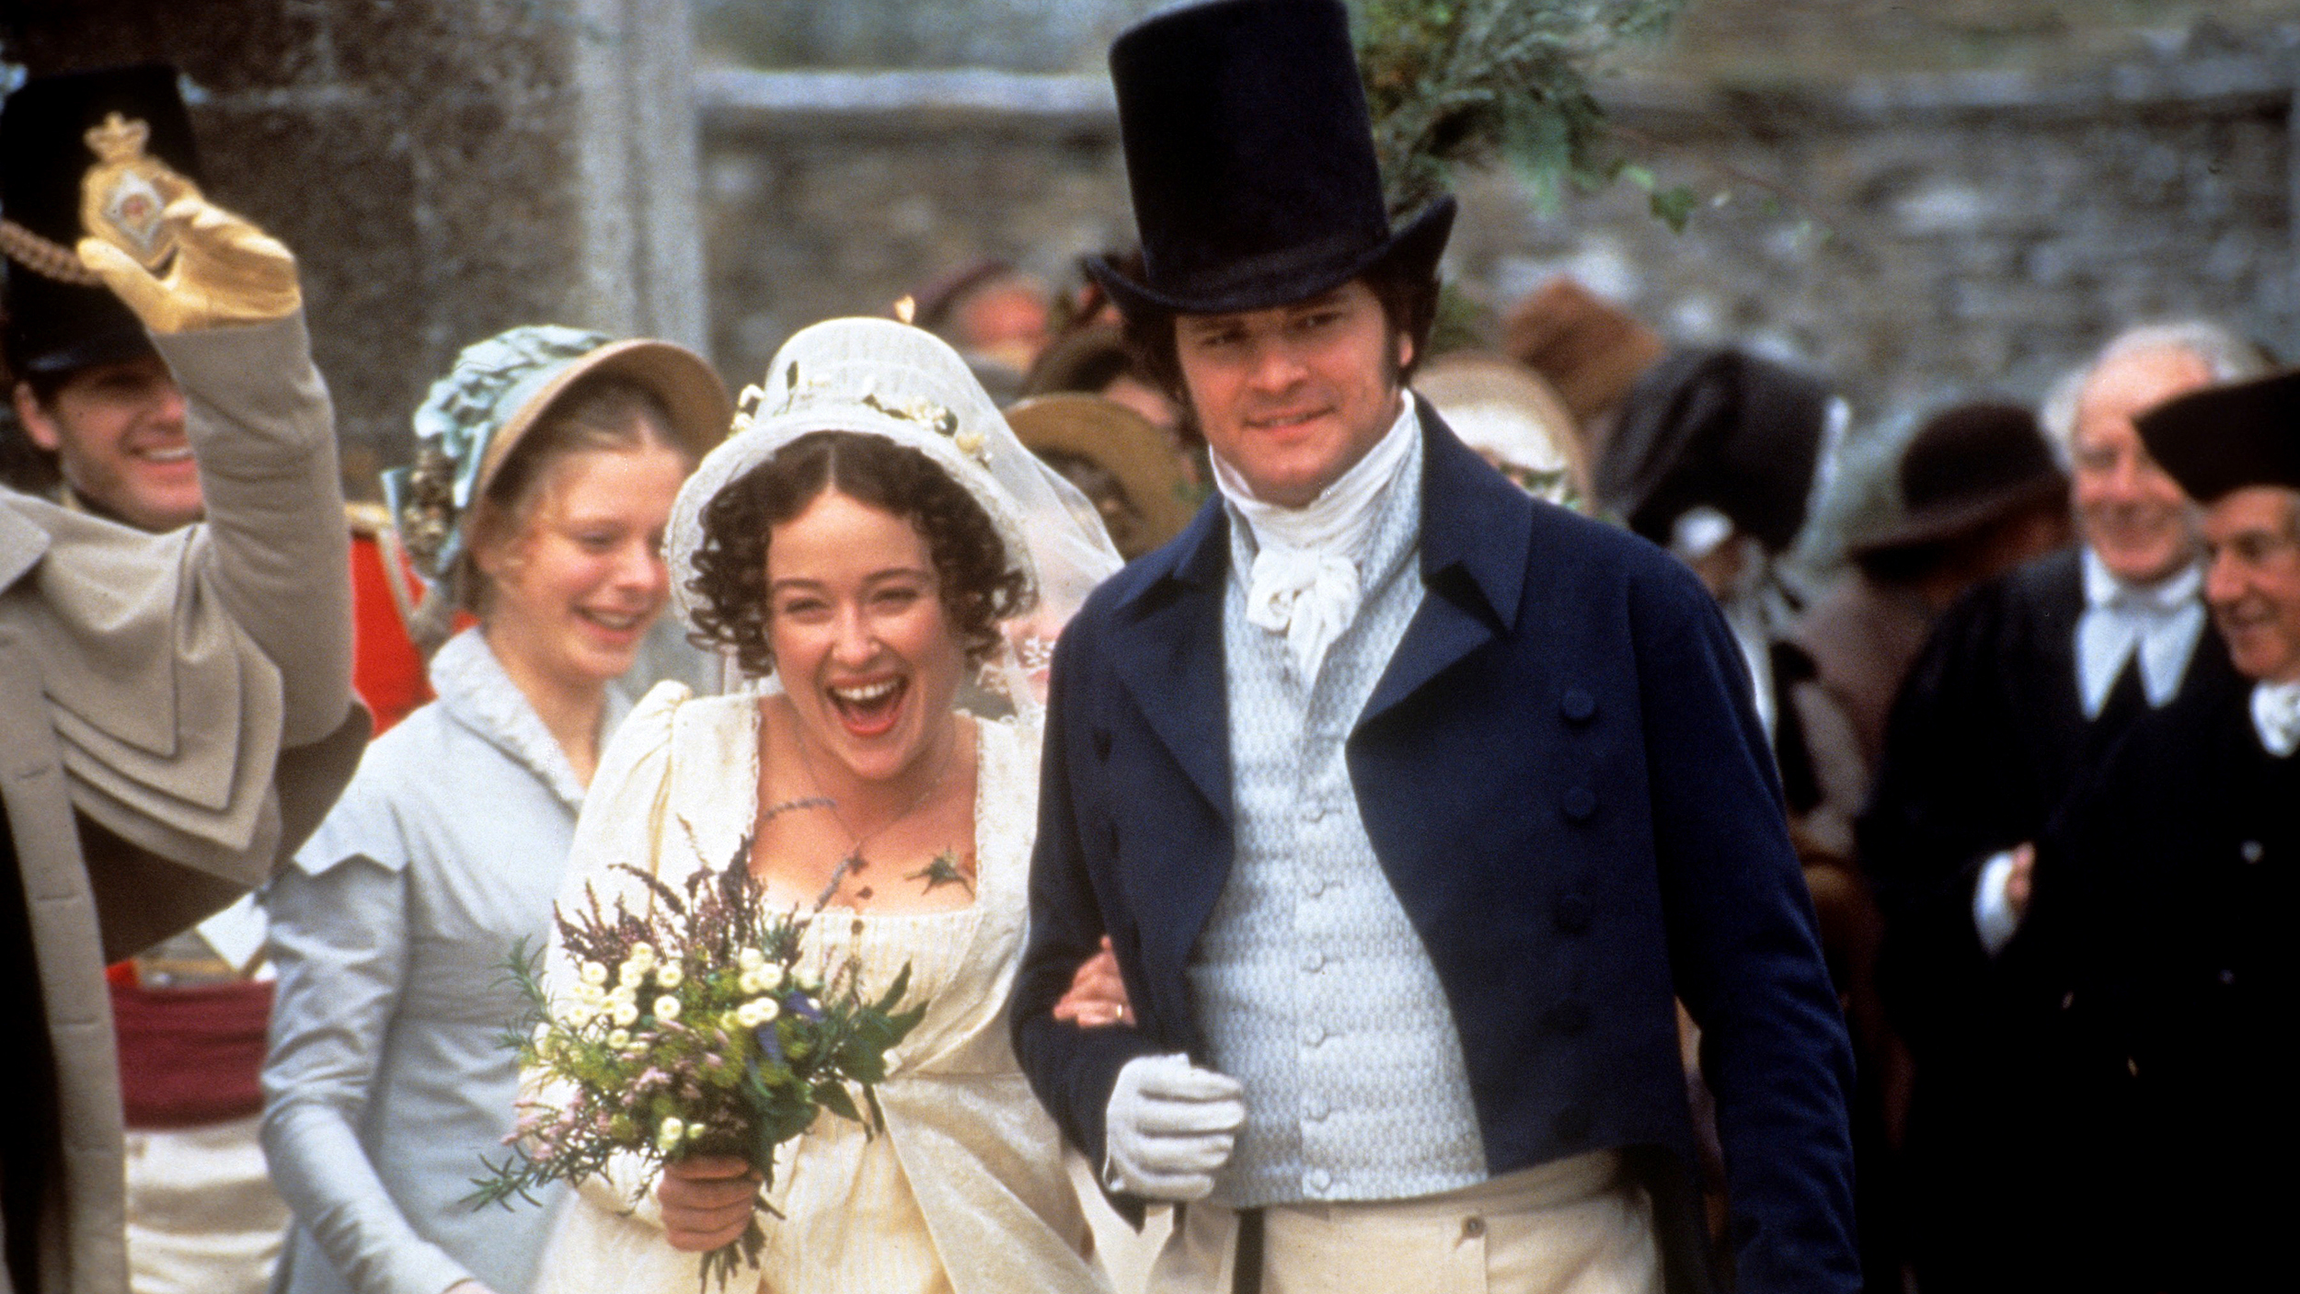
Who’s who in Pride and Prejudice?
Mr Darcy and Elizabeth Bennet

Slide 4
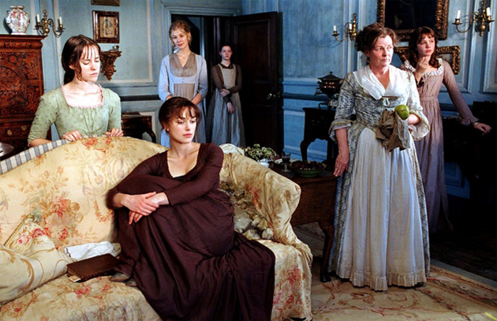
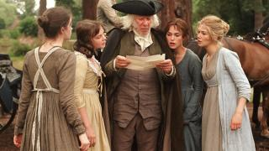
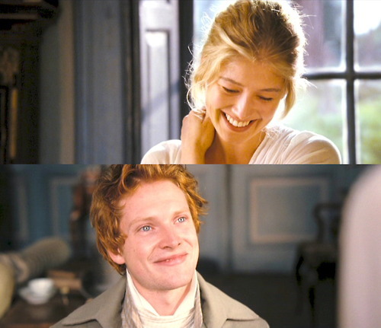
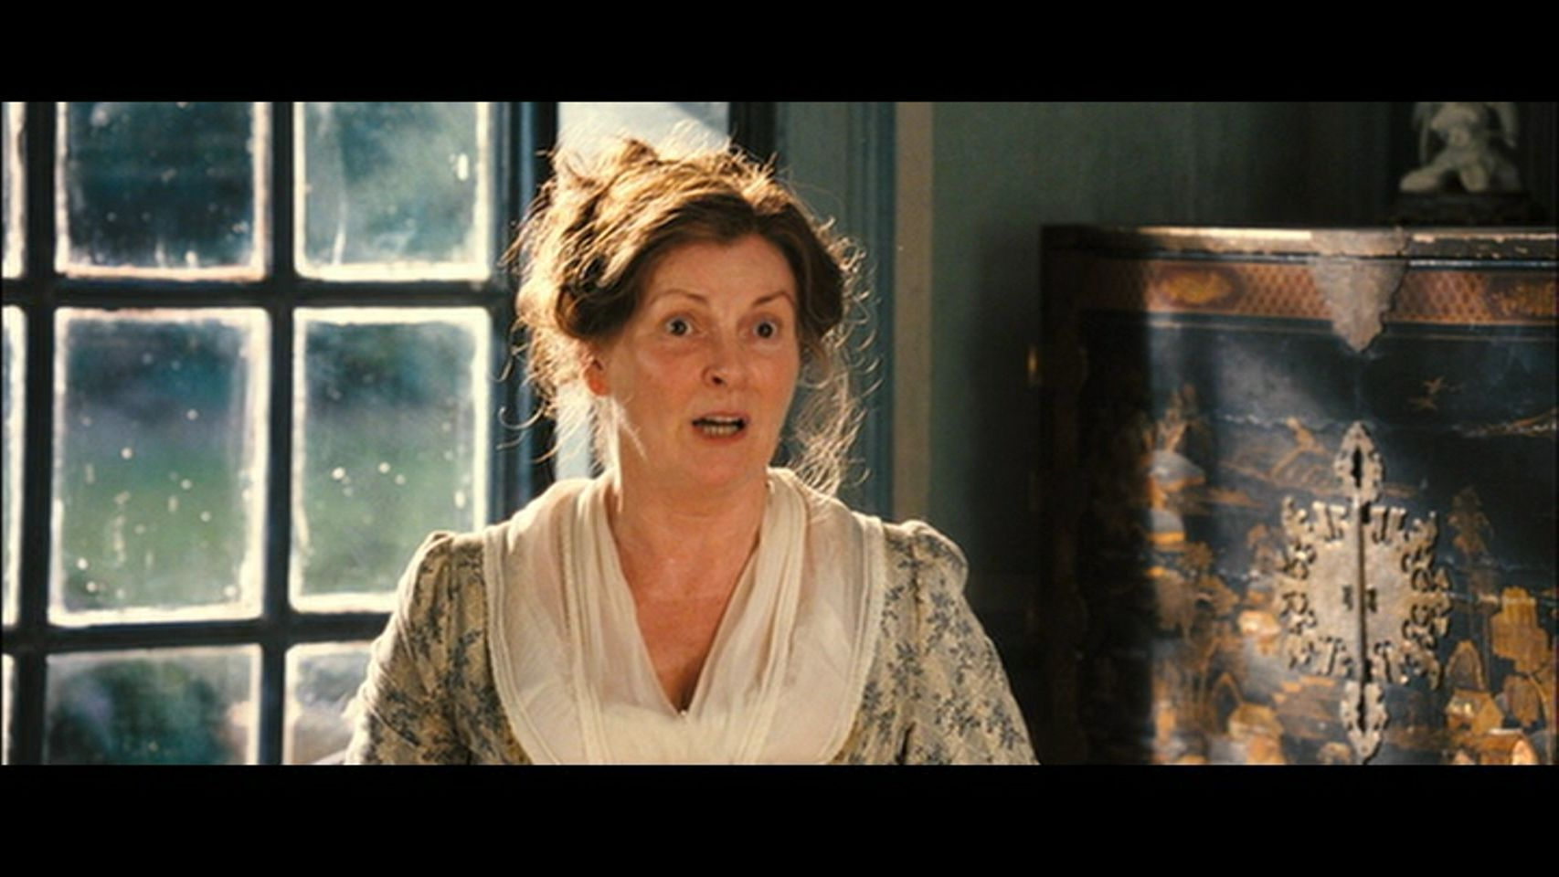
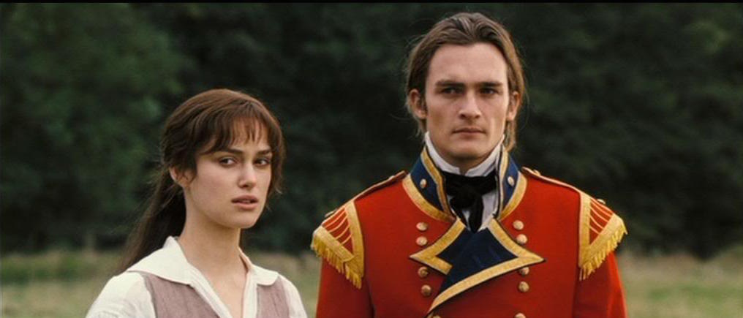
Who’s who in Pride and Prejudice?

Slide 5
Read the excerpt from Chapter One
What do you think about the famous opening line?
What event and topic is introduced right from the start?
What is revealed about the characters, their relationships to each other, and their different attitudes?

Slide 6
Pride and Prejudice – Characters and Plot
Mr and Mrs Bennet have five daughters:
Jane
Elizabeth (Lizzy)
Mary
Catherine (Kitty)
Lydia

Slide 7
Pride and Prejudice – Characters and Plot
Mrs Bennet dearly wants her daughters to get married. Mr Bennet may also want this, though with a different approach.
Mr (Charles) Bingley is a wealthy young bachelor arriving in town and renting Netherfield Park.
His friend Mr (Fitzwilliam) Darcy is also very wealthy.

Slide 8
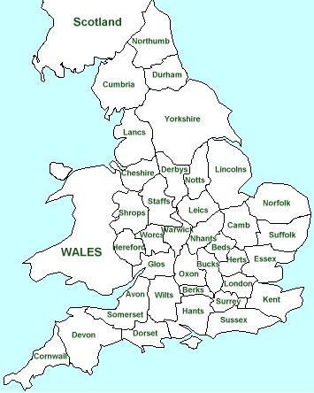
Derbyshire
Hertfordshire

Slide 9
Chapter 3 Excerpt:
How does the style of Austen’s narration differ from that in the Chapter 1 excerpt?
How is the passage of time, and characterisation, treated in the narrative?
Where is ‘pride and prejudice’ shown?

Slide 10
Plot Developments; Chapter 34 Excerpt:
Mr Darcy advises Mr Bingley that Jane isn’t interested in him.
Mr Collins (a cousin to the family) asks Elizabeth to marry him. She declines.
Chapter 34 – What happens in the conversation between Darcy and Elizabeth?
How might it be considered as showing ‘realism’?

Slide 11
Plot Developments; Chapter 58 Excerpt:
The fourth Bennet sister, Kitty, runs off with a soldier, Mr (George) Wickham.
Mr Bennet – and Mr Darcy, quietly – go to rescue Kitty and make sure Mr Wickham marries her.
Chapter 58 – What happens in the conversation between Darcy and Elizabeth?
How does ‘realism’ help to convey the romance?
Where are ‘pride’ and ‘prejudice’ mentioned?

Slide 12
How are the themes in Pride and Prejudice portrayed?
Marriage - For love? For money? For security?
Social class - Overcoming the barriers of class.
Pride and Prejudice - Overcoming pride and prejudice to find love

Slide 13
Are they treated realistically?
Marriage - For love? For money? For security?
Social class - Overcoming the barriers of class.
Pride and Prejudice - Overcoming pride and prejudice to find love

Slide 14
Pride and Prejudice – Appraisal
Is it a good novel? Is it a classic of English Literature?
Charlotte Bronte wrote to her editor about Austen in 1850:
"Why do you like Jane Austen so very much? I am puzzled on that point. ... I had not seen Pride and Prejudice till I read that sentence of yours, and then I got the book. And what did I find? ...a commonplace face; a carefully fenced, highly cultivated garden, with neat borders and delicate flowers; but no glance of a bright vivid physiognomy, no open country, no fresh air, no blue hill, no bonny beck. ... These observations will probably irritate you, but I shall run the risk."

Slide 15
Pride and Prejudice – Appraisal
Charlotte Bronte wrote in a further reply:
“You say I must familiarize my mind with the fact that 'Miss Austen is not a poetess, has no "sentiment" ... no eloquence, none of the ravishing enthusiasm of poetry'; and then you add, I must 'learn to acknowledge her as one of the great artists, of the greatest painters of human character, and one of the writers with the nicest sense of means to an end that ever lived.’ “
"That last point only will I ever acknowledge."
"Can there be a great artist without poetry? ... But by 'poetry', I am sure you understand something different to what I do, as you do by 'sentiment'. ... I submit to your anger, which I have now excited (for have I not questioned the perfection of your darling?); the storm may pass over me. ..."

Slide 16
Pride and Prejudice – Appraisal
"I have likewise read one of Miss Austen's works Emma—read it with interest and with just the right degree of admiration which the Miss Austen herself would have thought sensible and suitable—anything like warmth or enthusiasm; anything energetic, poignant, heartfelt, is utterly out of place in commending these works: all such demonstration the authoress would have met with a well-bred sneer, would have calmly scorned as outre and extravagant. She does her business of delineating the surface of the lives of genteel English people curiously well; there is a Chinese fidelity, a miniature delicacy in the painting: she ruffles her reader by nothing vehement,…

Slide 17
Pride and Prejudice – Appraisal
disturbs him by nothing profound: the Passions are perfectly unknown to her; she rejects even a speaking acquaintance with that stormy Sisterhood; even to the Feelings she vouchsafes no more than an occasional graceful but distant recognition; too frequent converse with them would ruffle the smooth elegance of her progress. ... Jane Austen was a complete and most sensible lady, but a very incomplete, and rather insensible (not senseless) woman, if this is heresy—I cannot help it. If I said it to some people (Lewes for example) they would accuse me of advocating exaggerated heroics, but I am not afraid of your falling into any such vulgar error."

Slide 18
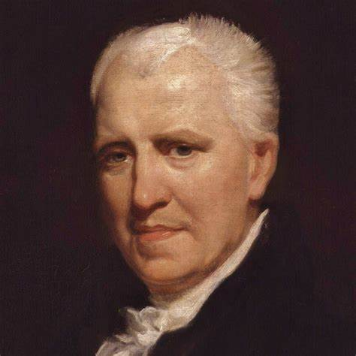
Peter Grimes, 1810 (Part of The Borough collection of poems)
Reverend
George Crabbe
(1754-1832)

Slide 19
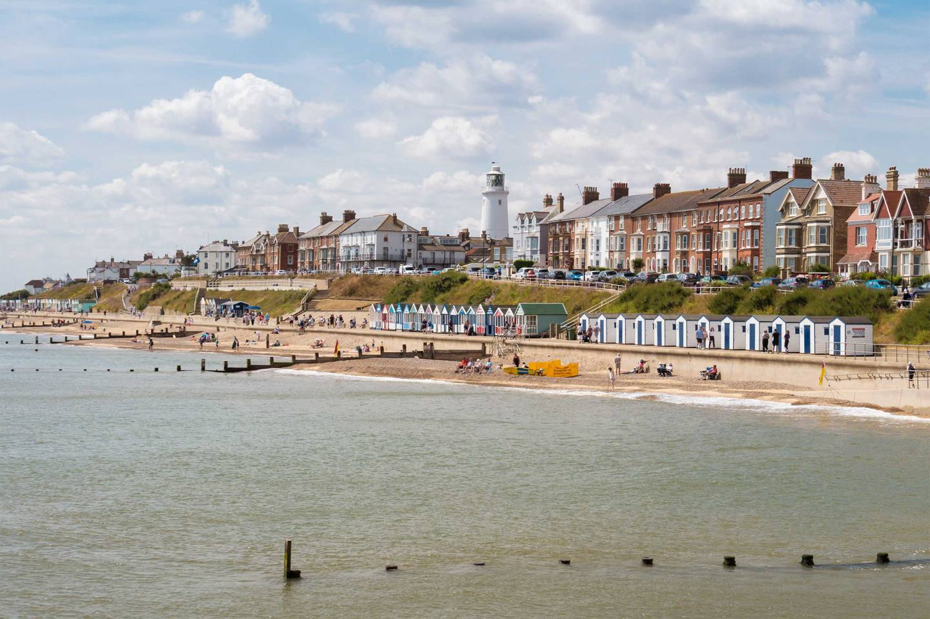
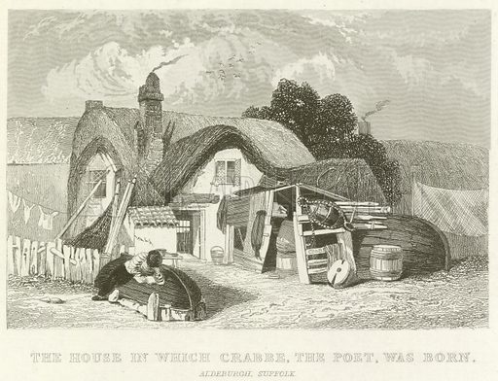
George Crabbe
He was born in a poor seaside town and was training to be a surgeon.
He wrote to Edmund Burke (a famous politician and thinker), who helped him to publish his poetry and become a vicar in the church.
Adelburgh in Suffolk, where George Crabbe was born

Slide 20
Peter Grimes – analysis:
What happens in the poem?
How is it structured?
What is the character of Peter Grimes like? What is his back-story? How does he act?
Is justice served in the poem?
What is Peter guilty of?

Slide 21
Creative Writing – choose either:
Write a stanza about a criminal activity or social ill.
– you could use some rhyme, or a different structure.
– try to communicate ‘realism’.
Write a couple of paragraphs, or some lines of dialogue, which show a real-life situation.
– you could add an ironic tone, as the narrator, to help comment on some aspects of real life or feeling.

Slide 22
Academic Writing:
Write a couple of academic paragraphs to:
Compare and contrast the ‘realism’ of the contemporaneous writers Jane Austen and George Crabbe, in their respective works, Pride and Prejudice and Peter Grimes.

Slide 23
Homework
Please read two poems from the period of Romanticism, and one from the mid-nineteenth century.

